Slide 1
A Machine Learning Approach to Predict House Pricing System
by
JANANI J
220701097
Guide
Dr. Auxilia Osvin Nancy, MTech., Ph.D.,

Slide 2
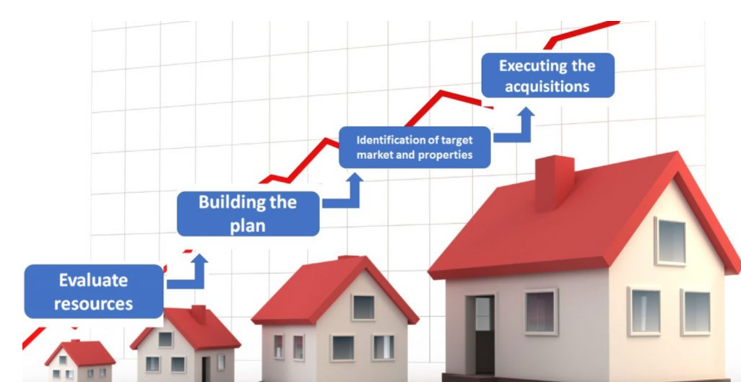
Introduction
Project Aim: The goal is to build a house price prediction model using Linear Regression on publicly available housing datasets, enabling more accurate and automated valuation.
Motivation: Traditional pricing methods rely on manual and expert appraisal, while machine learning offers data-driven, objective, and scalable alternatives.
Model Features: The model uses property attributes such as location, size, number of rooms, and neighborhood factors to predict prices.
Evaluation Metrics: The performance of the model is measured using MAE, MSE, RMSE, and R², ensuring robust and interpretable results.

Slide 3
Literature Survey
Linear Regression is widely used for predicting house prices due to its simplicity and interpretability.
Housing prices are strongly influenced by features like location, number of rooms, and area size.
Regression models provide a baseline for comparing more complex machine learning algorithms.
Feature selection and normalization significantly improve the accuracy of regression-based models.
Linear Regression performs well when the relationship between features and price is approximately linear.

Slide 4
Literature Survey
Outliers and multicollinearity can negatively impact the performance of Linear Regression models.
Data preprocessing steps such as handling missing values and encoding categorical variables are critical.
Linear models are computationally efficient and suitable for real-time or large-scale price predictions.
Visualization of residuals helps identify patterns not captured by linear models.
Regression metrics like MAE, MSE, and R² are standard tools to assess prediction accuracy.

Slide 5
Objectives
To develop a predictive model that estimates house prices based on various property features.
To apply Linear Regression for modeling the relationship between housing attributes and price.
To evaluate model performance using standard metrics like MAE, MSE, RMSE, and R² score.
To identify and understand the key factors that most influence housing prices.
To create a transparent and interpretable model suitable for real estate decision-making.
To use data preprocessing techniques to improve model accuracy and reliability.

Slide 6

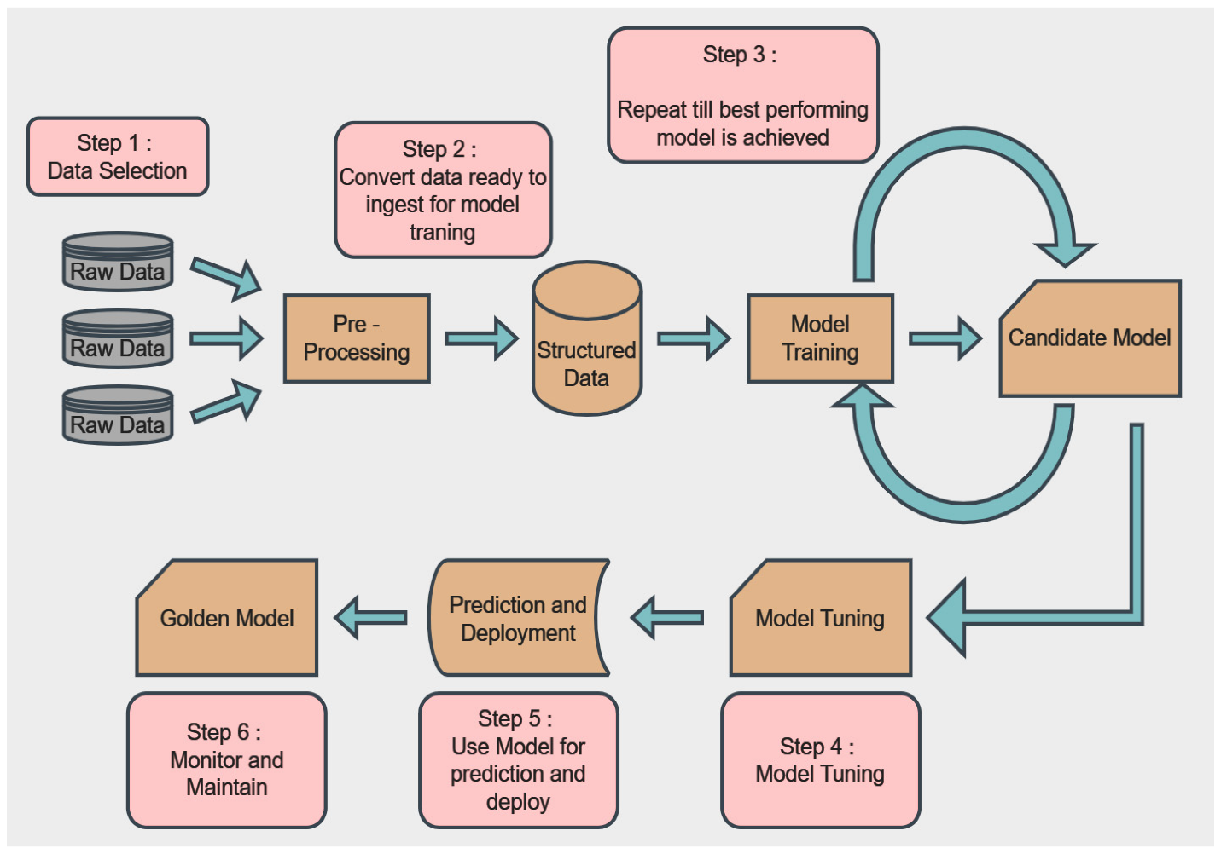
System Architecture

Slide 7
Methodology
Data Collection: Use a publicly available housing dataset with various features like location, size, and number of rooms.
Data Preprocessing: Clean the dataset by handling missing values, encoding categorical variables, and normalizing numeric features.
Feature Selection: Identify the most relevant features that influence house prices using correlation analysis.
Model Building: Apply Linear Regression to model the relationship between selected features and the house price.
Model Evaluation: Assess model performance using MAE, MSE, RMSE, and R² to measure prediction accuracy.
Visualization: Use plots to visualize feature impact and residual errors to evaluate model fit.

Slide 8
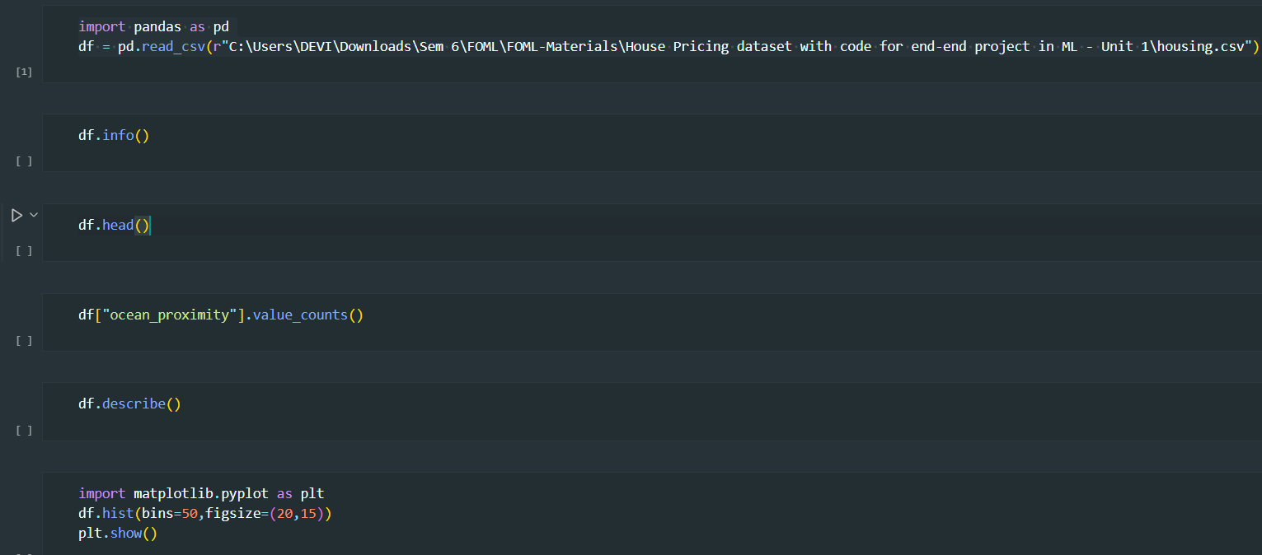
Implementation

Slide 9
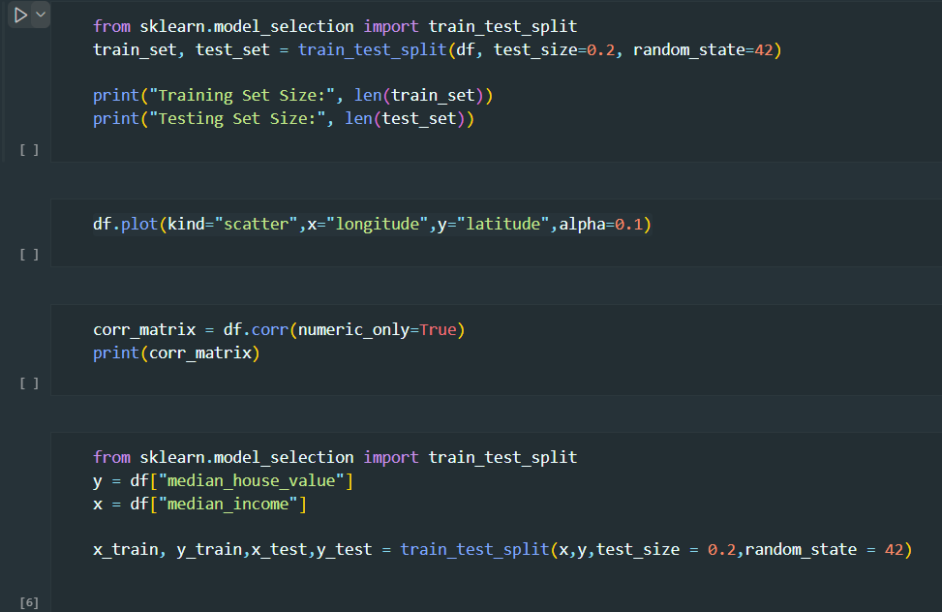
Implementation

Slide 10
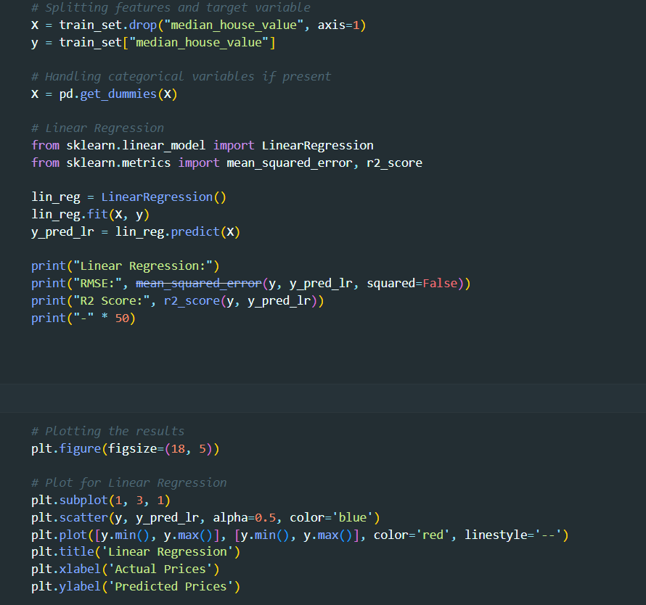
Implementation

Slide 11
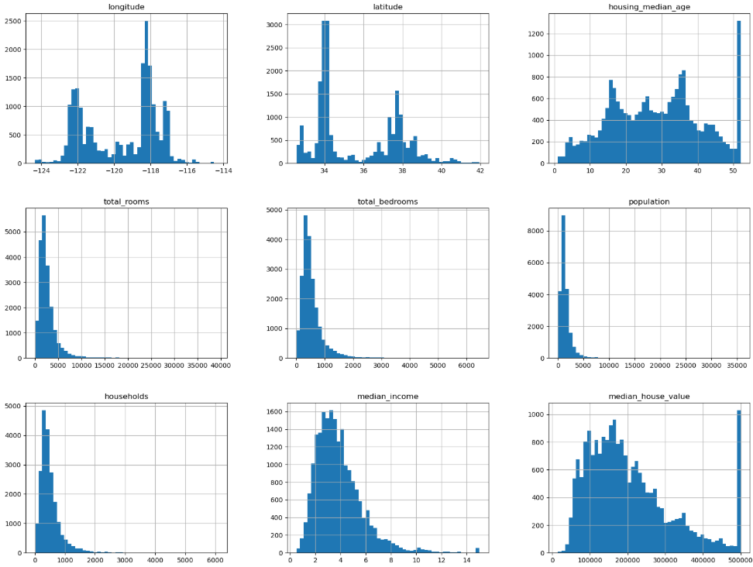
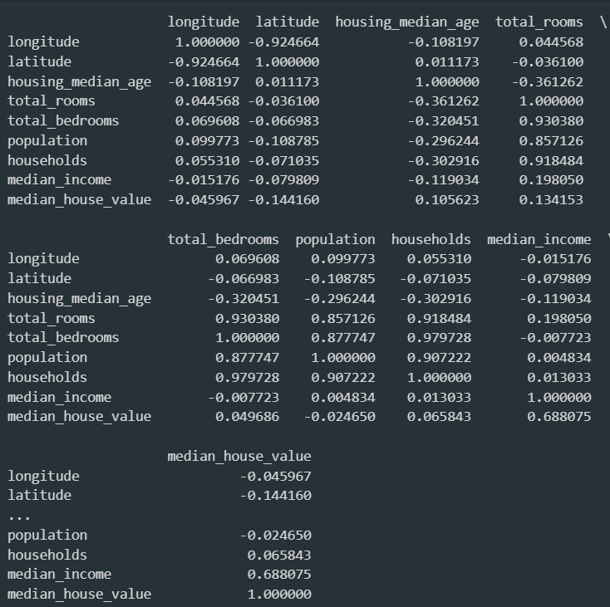
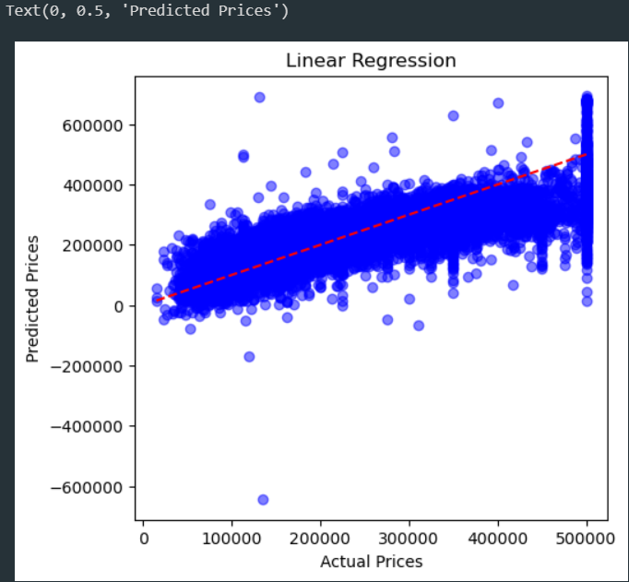
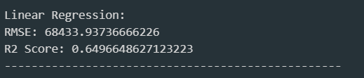
Results

Slide 12
Comparison with existing work
Traditional appraisal methods rely on manual evaluations, while Linear Regression automates price prediction with greater speed and consistency.
Human-based estimation is subjective and may vary, whereas Linear Regression provides objective, data-driven predictions.
Comparative Market Analysis (CMA) requires expert judgment, while Linear Regression models can learn from historical data without expert intervention.
Non-linear models like Random Forests capture complex patterns but lack interpretability, whereas Linear Regression is transparent and easily interpretable.
Machine learning models like XGBoost offer higher accuracy but at the cost of increased complexity, whereas Linear Regression balances simplicity and efficiency.

Slide 13
Conclusion and Future Work
Conclusion
The Linear Regression model effectively predicts house prices based on key property features.
The model offers interpretable results, making it useful for stakeholders like buyers and agents.
Evaluation metrics confirm that Linear Regression serves well as a reliable baseline for price prediction.
Future Work
Advanced models like Random Forest or Gradient Boosting can be explored for improved accuracy.
Incorporating more diverse datasets and external economic factors may enhance prediction quality.
A web-based or mobile application can be developed to make the model accessible to end-users.

Slide 14
Reference
Kaggle Notebook: Housing Price Prediction (Linear Regression)
https://www.kaggle.com/code/ashydv/housing-price-prediction-linear-regression
Housing Price Prediction Based on Multiple Linear Regression
https://onlinelibrary.wiley.com/doi/full/10.1155/2021/7678931
A Comparative Study of House Price Prediction Using Linear Regression and Random Forest Models
https://drpress.org/ojs/index.php/HSET/article/view/23096
House Price Prediction Using Data Mining with Linear Regression and Neural Network Algorithms
https://ejournal.kresnamediapublisher.com/index.php/jri/article/view/262

Slide 15
THANK YOU

